Slide 1

Pennsylvania’s
Student Learning Objective Process
Overview for Music Educators

Slide 2
Session Objectives
Review Teacher Effectiveness System
II. Define SLO process
III. Exploring SLO Template 10
IV. Identifying Key Points for
Music Teachers
Notes:
How many have heard about SLO’s? How many have worked on or completed an SLO?

Slide 3
I. Teacher Effectiveness System

Slide 4
The Most Important People In Your School
The Maintenance Supervisor
The Office Secretaries
The Tech Guy/Gal
The Business Manager
These people will make your job either pleasurable or miserable, so you should take care of them (presents, etc.)!
Notes:
Before we talk about the teacher eval. system, be aware of this.

Slide 5
Your Best Resources For All Things Teacher Evaluation
Your district Curriculum Coordinator
Your building Principal
Your mentor teacher (or any successful colleague)
Your local IU (CSIU, Blast IU, etc.)
  At CSIU:
    Susan Blythe, sblythe@csiu.org
    Chris Mitcheltree, cmitcheltree@csiu.org
At PDE:
  O. David Deitz, oddeitz@comcast.net

Slide 6
Notes:
What piece of the puzzle is the SLO in the Teacher Effectiveness System?
The SLO is the Elective Data in the Teacher Effectiveness System. Your position determines the percentage the Elective Data plays in your final evaluation.
This year the Elective Data is optional for a teacher’s evaluation ; next year it is effective.

Slide 7
Notes:
Refer to Rating Form PDE 82-1

Slide 8
Frequency Of Evaluations and SLO’s
Evaluations:
Level I Teachers: Semi-Annually
Level II Teachers: Annually*
SLO’s:
TBA - either annually or semi-annually
*Districts choosing the Differentiated Supervision Model can do formal evaluations less frequently than annually, but must still evaluate domains 2 & 3, which cannot really be accomplished without a formal evaluation.

Slide 9
Observation/Evidence (50%)
Charlotte Danielson’s
Framework for Teaching
4 Domains, 22 Components
Principal/Evaluator Observes

Slide 10
Domain 1:
Planning and Preparation
1a Demonstrating Knowledge of
Content and Pedagogy
1b Demonstrating Knowledge of
Students
1c Setting Instructional Outcomes
1d Demonstrating Knowledge of
Resources
1e Designing Coherent Instruction
1f Designing Student Assessments

Slide 11
Domain 2:
Classroom Environment
2a Creating an Environment of
Respect and Rapport
2b Establishing a Culture for
Learning
2c Managing Classroom
Procedures
2d Managing Student Behavior
2e Organizing Physical Space

Slide 12
Domain 3: Instruction
3a Communicating With Students
3b Using Questioning and
Discussion Techniques
3c Engaging Students in Learning
3d Using Assessment in Instruction
3e Demonstrating Flexibility and
Responsiveness

Slide 13
Domain 4:
Professional Responsibilities
4a Reflecting on Teaching
4b Maintaining Accurate Records
4c Communicating with Families
4d Participating in a Professional
Community
4e Growing and Developing
Professionally
4f Showing Professionalism

Slide 14
Educators are rated in
each domain:
Unsatisfactory or Failing, Level I
Basic, Level 2
Proficient, Level 3
Distinguished, Level 4
Educators should expect and strive
to “live” in Level 3, and “visit” Level 4.

Slide 15
Options For Evaluating Staff
Teachscape (Danielson “approved”)
PA-ETEP
Marzano
Many, many others
Paper and pencil
Notes:
Teachscape
Many using PA-ETEP
Marzano has their own software solution (Lewisburg)
Many, many others – receive advertisements daily
Paper & pencil - Danville

Slide 16
Multiple Measures of
Student Achievement
Building Level Data (School Performance Profile)
  Academic Achievement, Graduation/Promotion Rate, Attendance, AP-IB Courses offered, PSAT, SAT, Building Level PSSA and Keystone Assessment Data
Correlation Data Based on Teacher Level Measures
PSSA, Keystone Data
3. Elective Data (SLOs)

Slide 17
II. SLO Process

Slide 18
What is an SLO?
  A process to
  document a
  measure of educator effectiveness
  based on student
  achievement of
  content standards.
Notes:
Creating a SLO is a process…..The process demonstrates the teacher’s impact on student learning.
Read the statement on this slide. Take note of the colored words.
Other states have models where teachers choose an SLO from a menu provided by the state.
In PA…it’s a local choice in the development of an SLO.

Slide 19

The SLO Process: Creating a Relationship
Standards Based Education
Measurement of Student Achievement
Measurement of Educator Effectiveness
Notes:
The Student Learning Objective process creates a relationship between student achievement and teacher effectiveness under the umbrella of standards based education. An SLO is about linking student achievement of measurable, standards aligned objectives to effective teacher practice. A strong/healthy SLO will inform effective teacher practice as well as provide measurement of student achievement and teacher effectiveness.
The overarching question is: How will I move students from point A to point B?

Slide 20
THE PA SLO TEMPLATE & PROCESS
What it is supposed to be:
What it is not supposed to be:
A format to inform strong instructional practice and strong student achievement
A way to measure teacher effectiveness based on student achievement
An opportunity for teachers to define, describe and present data on student achievement in the content area that they teach
More paperwork for teachers that has no meaning or purpose
More testing for students
A weak substitute for PVAAS or other standardized testing data
Notes:
The SLO Template and Process are designed to help teachers positively demonstrate the ways in which they are effective through valuable learning objectives that are content specific. Initial attempts to create SLOs will be both thought provoking and time consuming but should inform strong instructional practice, this being a primary goal of teacher effectiveness. A quality SLO can inform strong instructional practice without increasing the amount of testing that students and teachers currently experience.

Slide 21
The SLO in PA is written to a specific teacher and a specific class/course/content area for which that teacher provides instruction.
The SLO: It’s Yours!
Notes:
The SLO is yours. It is written by you and for you….It targets a specific class or sub group of students in your class…in the course in which you provide instruction….in the course where you address specific standards.

Slide 22
1 Set of Students + 1 Subject = 1 SLO
Each teacher will choose ONE set of students and ONE subject area that they teach to write ONE Student Learning Outcome.
Think of it as providing a water sample of your teaching or a show and tell about what you do as an educator.
Notes:
An elementary teacher will choose one subject that he/she teaches. Secondary teachers will choose one class of one subject that they teach. Only ONE SLO is required from each teacher; however you may choose multiple.

Slide 23
Many factors can influence the size of an SLO,
Time Frame
Course Content
Important Learning Needs
but the process remains the same………..

Slide 24
SLO Process Design
SLO Goal
Indicator #1
Assessment #1a
Assessment #1b
Indicator #2
Assessment #2
Goal-Standards
Indicator
Performance Measures

Slide 25
C R I T E R I A
Goals are based upon the “big ideas” within the content standards.
Performance indicators are specific, measureable, attainable, and realistic.
Performance measures should be valid, reliable, and rigorous assessments.
Data should be collected, organized, and
reported in a consistent manner.
Teacher expectations of student
achievement should be demanding.
Notes:
The criteria is each section of the template. Follow the template as I explain the criteria.
Classroom Context: describes your class. It could be a single class or multiple.
SLO Goal is standards based. It’s the big idea on which the SLO is based.
Performance indicators: relates to the expected level of achievement.
Performance measures: the assessment and scoring tools...rubrics, data tracking
Teacher Expectations: teacher expectations of student achievement.

Slide 26
III. SLO Template 10.0

Slide 27
SLO Template 10.0 Process
  A tool used to identify goals, indicators, and performance measures for use in the greater Teacher Effectiveness System
Handout: SLO Template
Notes:
Refer to template and examples, and Help Desk document.

Slide 28
SLO Template Design
Context
Goal
Indicators
Measures
Expectations

Slide 29
SLO Template Steps: Teacher
Classroom Context
1a. Name |  | 1b. School |  | 1c. District
1d. Class/ Course Title |  | 1e. Grade Level |  | 1f. Total # of Students
1g. Typical Class Size |  | 1h. Class Frequency |  | 1i. Typical Class Duration
2. SLO Goal
2a. Goal Statement
2b. PA Standards
2c. Rationale

Slide 30
  Spanish 1
Students will be able demonstrate effective communication in the target language by speaking and listening, writing, and reading.
  8th Grade Art
  Students will demonstrate the ability to manipulate visual art materials and tools to create works based on the ideas of other artists and to evaluate the processes and products of themselves and other artists.
  2a.
  The SLO Goal Statement:
  What’s the Important Learning?
Notes:
Refer to Goal Sheet, Targeted Content Standards, Discuss PMEA form – yellow.

Slide 31
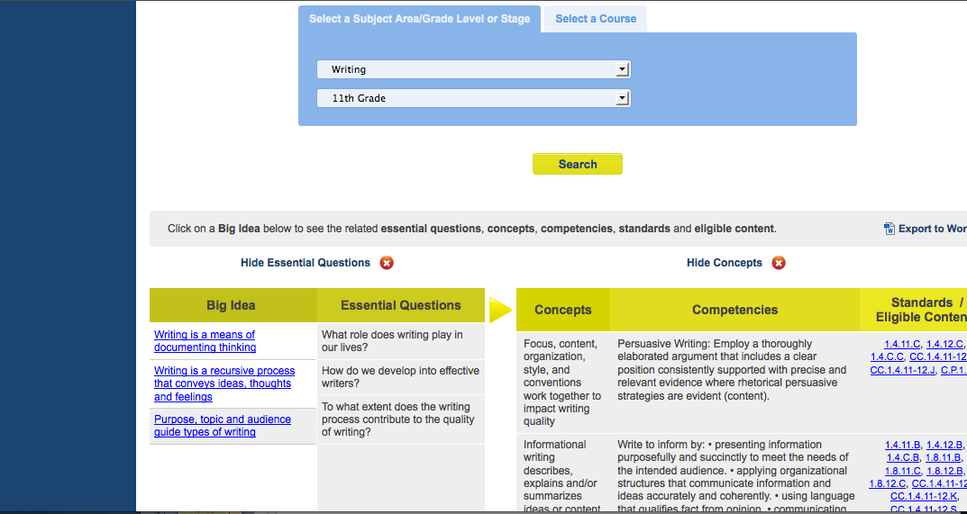
Help for the Big Ideas -- SAS: Curriculum Framework

Slide 32
  Targeted content standards used in developing the SLO.
  Arts and Humanities:
  9.1, 9.2, 9.3, 9.4
  http://pdesas.org/
2b.
Standards selection:
What Standards Match the
Goal Statement?

Slide 33
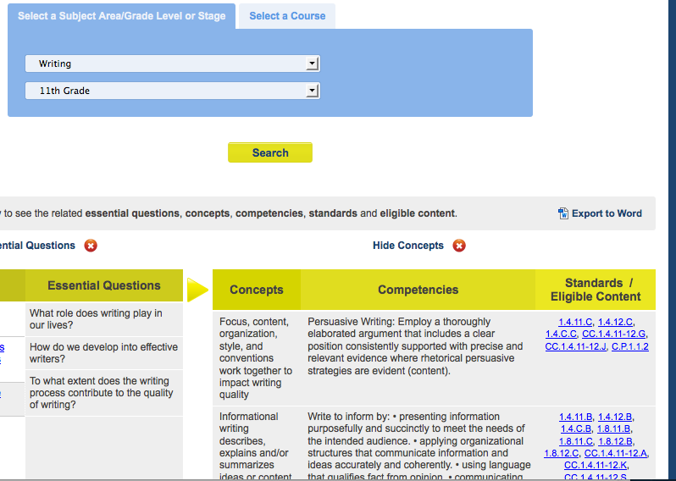
What standards match the goal statement?
Targeted content standards used in developing the SLO

Slide 34
  Explains why the SLO is important and how students will demonstrate learning of the standards through this objective.
2c.
Rationale statement:
Why is this Learning Important?
Grade 8 Art:
Developing the ability to manipulate visual art materials and tools are important to the artistic creation process, as is the ability to evaluate the process and product created by oneself and others.
Child Development (FCS)
Understanding how children grow and develop will prepare individuals and families to meet challenges associated with raising children.
Notes:
Rationale can be adapted essential question

Slide 35
SLO Template Steps: Teacher
3. Performance Indicators (PI)
3a. PI Targets: All Student Group | PI Target #1 PI Target #2 PI Target #3 PI Target #4 PI Target #5
3b. PI Targets: Subset Student Group (optional) | PI Target #1 PI Target #2 PI Target #3 PI Target #4 PI Target #5
3c. PI Linked (optional) |  | 3d. PI Weighting (optional)

Slide 36
  Describes individual student
  performance expectation
  3a.
  What performance measure(s) –tests, assessments– will be used to measure student achievement of the standards, and what’s the expected student achievement level based on the scoring system for those measures?
  3b.
  What’s the expected achievement level for unique populations? (IEP, students who did not do well on a pre-test, etc.)
3: Performance Indicator: What does Student Performance Look Like?

Slide 37
Performance Indicator Statement
HS Choral
Individual Vocal Assessment Task
Students will achieve proficient or advanced levels in 6 out of 8 criteria of the second scoring rubric.
5th Grade ELA
DRA text gradient chart
Students will demonstrate one year of reading growth

Slide 38
SLO Template Steps: Teacher
4. Performance Measures (PM)
4a. Name | PM #1 PM #2 PM #3 PM #4 PM #5 |  | 4b. Type | ____District-designed Measures and Examinations ____Nationally Recognized Standardized Tests ____Industry Certification Examinations ____Student Projects ____Student Portfolios ____ Other:______________________________
4c. Purpose | PM #1 PM #2 PM #3 PM #4 PM #5 |  | 4d. Metric | Growth (change in student performance across two or more points in time) Mastery (attainment of a defined level of achievement) Growth and Mastery
4e. Administration Frequency |  | PM #1 PM #2 PM #3 PM #4 PM #5 | 4f. Adaptations/ Accommodations | IEP ELL | Gifted IEP Other
4g. Resources/ Equipment |  | PM #1 PM #2 PM #3 PM #4 PM #5 | 4h. Scoring Tools | PM #1 PM #2 PM #3 PM #4 PM #5
4i. Administration & Scoring Personnel |  | PM #1 PM #2 PM #3 PM #4 PM #5 | 4j. Performance Reporting | PM #1 PM #2 PM #3 PM #4 PM #5

Slide 39
Many things must be considered when building quality assessments.

Slide 40
Building Performance Measures and Tasks
What does a Teacher do to administer a performance measure?
What must a Student know and do to complete a performance measure?
How does a Teacher
score a performance
measure?

Slide 41
SLO Template Steps: Teacher
5. Teacher Expectations
5a. Level | Failing 0% to ___ % of students will meet the PI targets. | Needs Improvement ___% to ___% of students will meet the PI targets. | Proficient ___% to ___% of students will meet the PI targets. | Distinguished ___% to 100% of students will meet the PI targets.
.
Teacher Signature _________________________Date______ Evaluator Signature _____________________Date______
5b. Elective Rating | Distinguished (3) Proficient (2) Needs Improvement (1) Failing (0) | Notes/Explanation
.
Teacher Signature _________________________Date______ Evaluator Signature _____________________Date______
Notes:
Discuss Final Scoring Example.

Slide 42
Describes the number of students expected to meet the performance indicator criteria.
5a: Proficient
85% to 94% of students meet the performance indicator.
5a:
Teacher Effectiveness Measure

Slide 43
Proficient!
5a: Proficient
85% to 94% of this audience can explain the SLO process to their stakeholders!

Slide 44
SLO Process Online
Available Templates
Available Rubrics
My History
Resources
SAS: Homeroom

Slide 45

More SLO Support....

Slide 46
IV. Key Points for
Music Educators

Slide 47
Key Process Points
  The SLO process facilitates a conversation about expectation between educators (principals and teachers)

Slide 48
More Key Points
Very important to teachers that do not have teacher specific PVAAS scores attributed to them – music educators included!
35% of their evaluation will be based on their SLO.

Slide 49
Key Points (3)
Goals-Standards
Indicators
Performance Measures
What is the subject or content focus?
Who does it encompass?
How can it improve instruction and educator practice?
What are indicators of success?
How are they being measured?
Upon which students are they based?
Are they high quality measures?
Who administers and scores the measures?
What are the expectations for students?

Slide 50
IV. Areas of Caution
  The SLO is based upon small numbers of students/data points.
  Goals and indicators are not linked to standards.
  Indicators are vague without specific performance criteria.
  Growth and/or mastery is not clearly defined
  Performance measures are not well designed or lack rigor.
  Overall student achievement expectations are extreme.

Slide 51
IV. Generic Process Steps: Leader
  Establish SLO template completion timeline at beginning of year
  Review complete template
  Conduct review meeting with teacher
  Agree on any revisions; submit materials
  Establish “mid-cycle” spot review
  End-of-Year review with supporting data

Slide 52
Frequently Asked Questions
What are the definitions of “tested,” “non-tested?”
Tested: Teachers with Eligible PVAAS Score
(20% Elective)
A PA certified educator with full or partial responsibility for content specific instruction of the assessed eligible content as measured by a Grade 4-8 PSSA or Keystone Exam.
Non-tested: Teachers without Eligible PVAAS Score
(35% Elective)
Teachers who do not teach courses
assessed by Grade 4-8 PSSA or Keystone
exams.

Slide 53
Who develops the SLO? Is this an individual effort or a collaborative effort?
Each educator will be responsible to develop SLOs as required by the LEA. Collaborative development of SLOs is encouraged (e.g., similar content area or grade level teachers, interdisciplinary groups of educators, collaboration through professional organizations educators, etc.). A PDE approved SLO Template is provided to help guide educators and administrators through the process.
How will the final SLO measure be translated into a “score” that can be applied to the 20% or 35% of a teacher’s evaluation?
This formula and computation process is
currently under development by PDE
and will be published in the PA Bulletin by
June 30, 2013.

Slide 54
What is the SLO template and process designed to address in terms of instructional delivery time, number of students, or size of the objective?
SLOs can be written to address the entire length of a grade or course, but could be tailored to a focused time period. Student achievement for large or select groups of students can be described. The template is designed to address a grade or course plan but could be used to address a meaningful, focused instructional objective or focused teaching practice.
Will PDE recommend some performance measures and scoring tools?
Model SLOs for a variety of content areas will
be provided, utilizing a variety of performance
measures and scoring tools. These models
can be used as is or can be modified.

Slide 55
How many SLOs per teacher/per year/per grade? What about “co-taught” classes, teachers who travel between schools, and other unique instructional scenarios?
Policy and guidelines on these issues are yet to be determined.
How will the SLO process be monitored?
A principal or LEA-assigned evaluator would monitor the SLO process, including (but not limited to) the timeline for development, approval for the SLO to be implemented and verification of the measure of
educator effectiveness based on the completion of the SLO. Tools are currently being developed to
assist principals toward efficiently and
effectively monitoring this process.

Slide 56
How do “goals” and “performance indicators differ?
The Goal Statement should address important learning content to be measured, and the performance indicators should describe expected levels of achievement.
If a school is already having conversations about SLO and is having success, is it necessary to fill out this template or can we continue what we are doing?
State regulations say that “LEAs shall use an SLO to document the process to determine and validate the weight assigned to the Elective Data measures
that establish the Elective Rating.”

Slide 57
When will LEAs be expected to implement SLOs?
Models will be available for school year 2013-2014, and LEAs have the option to use SLOs as a component for measuring educator effectiveness in school year 2013-14. LEAs will be expected to implement SLOs in school year 2014-2015. First year teachers will not be expected to implement SLOs.
What supports will be available to teachers and districts to develop and implement rigorous SLOs?
An online training program and process/
definitions manual will be provided, as will
an up-to-date template and content-specific
models. Anticipated availability of these
supports is August 2013.

Slide 58
Important SLO Resources
http://pdesas.org
  SLO Learning Community in the Teacher Tools
http://homeroom.ria2001.org/login.php
  Register for an account
www.danielsongroup.org
  Danielson Framework

Slide 59
Your Questions?

Slide 60
Thank
You!
Notes:
Thank you to Ron Wasser & Brett Hosterman, Bernadette Boerkel, Susan Blythe!

